Slide 1

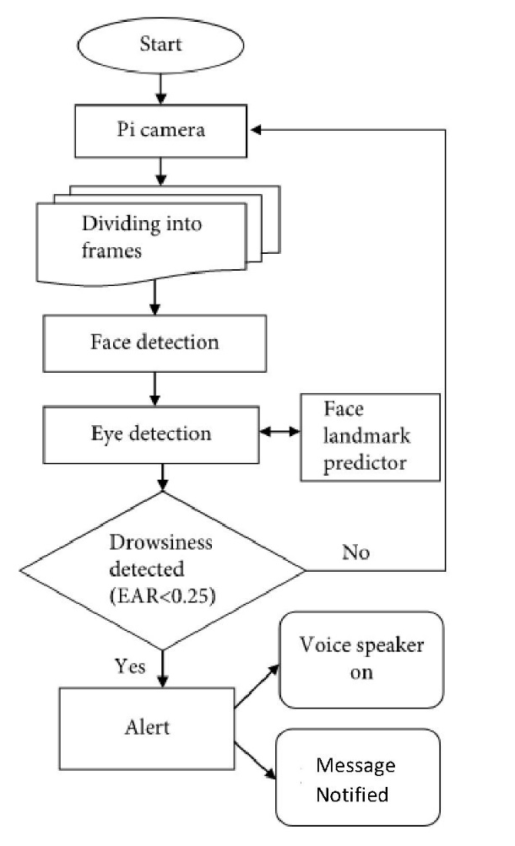
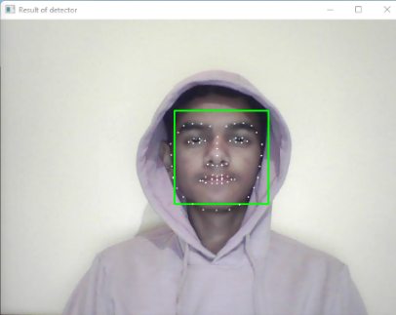


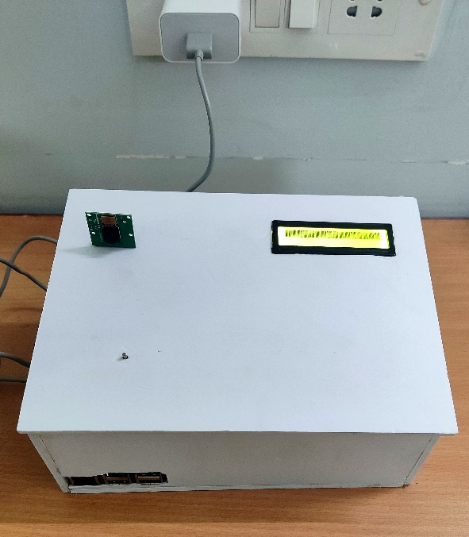
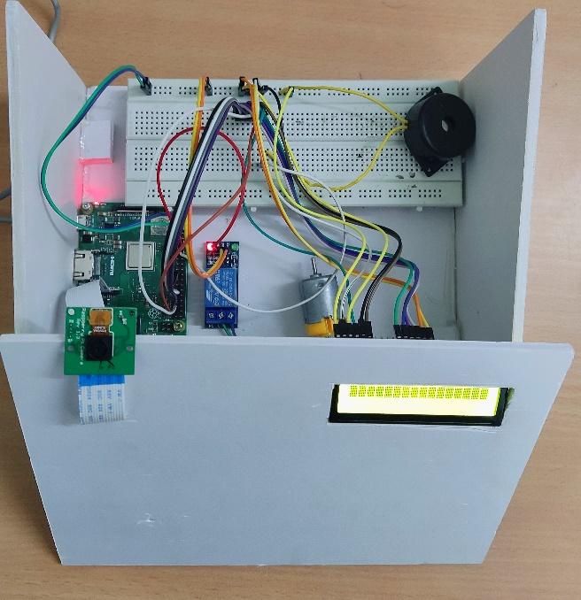
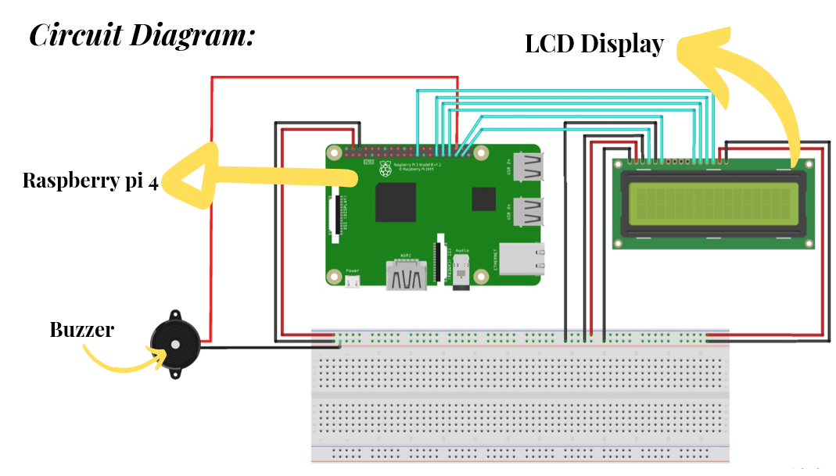
Detection of drowsiness of drivers face through IOT
Nipun Rajput(210C2030021), Ketan Thakur (210C2030029),
Godavarthi Sai Nikhil (210C2030030), Utkarsh Singh (210C2030031)
School of Engineering and Technology, BML Munjal University
Abstract
When a person is fatigued due to prolonged driving will tend to sleep during driving which can cause an accident, which in result will harm himself and possibly the people around him. Drowsiness is generally difficult to detect or monitor. So a real-time driver sleepiness detection system for driving safety is presented in this research. With the help of this project, we can reduce the number of accidents Occurring and spread awareness of driving an adequate amount of rest. We are mainly going to work on how to reduce accidents caused by fatigue. In India, the Ministry of Road Transport has announced that 40% of accidents are due to drowsiness. The scope of the project is good and you can use it in your late-night travels.
Key Words: Eye Detection, Drowsiness, Facial landmark Recognition.
Objective
Results/observation
Through this project, we are trying to reduce accidents happening due to drowsiness. In India, the ministry of road transportation revealed that 40% of accidents happen because of drowsiness.
The image or video will be captured from the Pi camera which is placed on the dashboard of the car and the video will be converted into multiple frames with the help of OpenCV. With the help of this device, it will capture the face of the drivers by the live video using the Dlib frame to detect both eyes. Then, utilizing open cv and open cv Classifier (a rectangle is formed around the face) as seen in the above figure, we use feature face extraction to calculate the position of the eye, then compare it to an open CV to recognize the eyes. Now we will move further with the help of OpenCV to calculate the ‘Euclidean function’ (Vertical and horizontal distance of eye to calculate the ratio of eye aspect).
The python software and Dlib library help us to detect the eye moments whereas the face is detected by a green box, now by using 68 Face Landmark the system will detect the eye moments.
These are some of the Screenshots of our Project:
We have researched and concluded that 91 out of 100% of accidents are happening due to driver’s error, 5% from Surrounding factors, and 4% due to vehicle technical problems. With the help of this project, we are going to detect the driver’s drowsiness.
Eye closure and blinking are continuously monitored, making behavioral measures among the fastest and easiest ways to detect drowsiness. To detect drowsiness we have to measure the Euclidean distance of the eyes.
Face, eye, and sleepiness detection are the three steps of the proposed method. The purpose of image processing is to recognize the driver's face and then extract the image of the driver's eyes for sleepiness detection. The face detection algorithm starts with image frames that have been collected and then processes them.
Figure (1.A). Open Eyes Result - Active
Figure (1.B). Drowsy Eyes Result - Drowsy
Figure (1.C). Close Eyes Result - Sleeping
Prototype (Image)
Conclusion
We developed an innovative device that detects driver drowsiness and can be installed in front of the driver in the car.
When the system detects either the driver getting tired or the driver is not paying attention while driving, then a warning will be triggered in this final stage. A buzzer within the Raspberry Pi is connected to the GPIO of the Raspberry Pi to generate a moderately loud beeping sound. This sound is meant to inform the driver if he or she is fatigued or inattentive. The duration of the average blink is about 100-400 milliseconds. The buzzer is triggered if a person is drowsy during a certain interval and the eye is closed for even more than 15 seconds.
These are some of our pictures of our Hardware project:
.
The Raspberry Pi 4 is the system's major component, which is used for the continuous capture of facial landmarks that are localized using facial points and then analyzed. Likewise, it gathers images from the video, which are rapid enough to recognize a driver's face. The framework makes use of open-Source software known as the "open CV" picture handling libraries. The general architecture is made out of a Raspberry Pi and an open CV to make it an easy-to-tired location framework. The buzzer goes off if the driver becomes drowsy and closes his eyes for more than a few seconds. As a result, the ratio of accidents drops. This equipment can tell a difference between normal eye blinks and fatigue, which prevents the driver from falling asleep behind the wheel. Even when drivers are wearing glasses or driving in low-light conditions, the device will work.
Euclidean is the distance between two locations. As you can see from the above two images, we have mentioned the points of both eyes. If (ratio>0.25) in the left eye from 43 to 48 and in the right eye from 37 to 42 the eye is opened and if (ratio>0.21 and ratio=0.25), the eye is closed.
Based on Cartesian coordinates, the Pythagorean theorem is used to calculate the Euclidean distance. In various statistical and optimization applications, the square of the Euclidean distance is applied instead of the distance itself. During monitoring, the equipment may detect if the eyes are open or closed. The buzzer beeps to inform the driver when he/she is in a state of drowsy (when the eyes are closed for around 15 seconds). If the device detects the drowsiness of the driver’s face, it will quickly display a drowsy message on the LCD and alert the driver through the buzzer’s sound to avoid accidents.
Future Outlook
The blink rate and status of the vehicle factors can be used to improve this model.
The device can also be attached to the accelerator to reduce the vehicle's speed and therefore the impact of the accident.
The system can be improved even more by employing an infrared camera for better picture quality in a variety of lighting circumstances, as well as for persons with brown complexions and small eyes.

